Slide 1
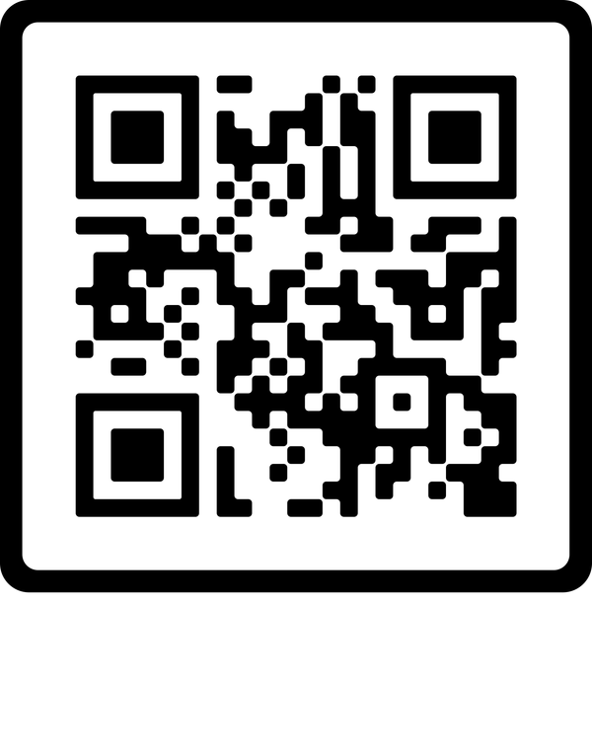






Join millions on Blue Sunday, a day of prayer for survivors of child abuse and those who speak up for them.
Volunteer
Donate
Pray
To become a Court Appointed Special Advocate for children.
To CASA of Denton County as we advocate for the best needs of children as they navigate the child welfare system.
For children and families affected by child abuse and neglect
Visit CASADenton.org
to learn more.

